Slide 1



FACIAL MASK DETECTION
COMPUTER VISION

Slide 2
TABLE OF CONTENTS
01
02
03
04
05
WHAT?
What is this about?
Why did we choose this topic?
WHY?
APPLICATIONS
Real life applications of this model?
OUR MODEL
What does our model do?
Ideas for additional features for the model.
IMPROVEMENTS?

Slide 3


01
WHAT?
WHAT IS OUR PROJECT ABOUT?

Slide 4
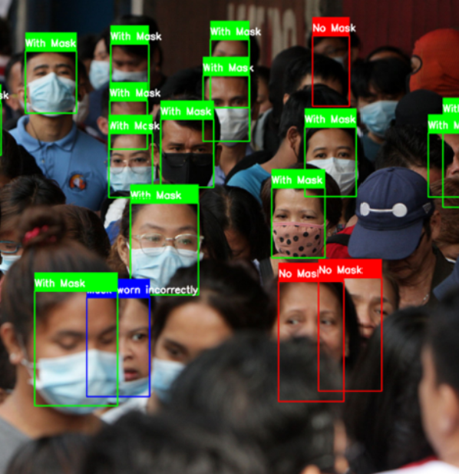
MASK DETECTION
A mask detection model is a computer vision or machine learning model designed to identify whether a person in an image or video is
Wearing mask or
Not wearing mask

Slide 5
02
WHY?
WHY DID WE CHOOSE THIS PROJECT?

Slide 6
Because..
1
Facial mask detection is a meaningful computer vision project that can have a positive impact on public health.
2
Provides valuable learning experiences and career development.
3
Aligns with real-world needs and offers a chance to apply technology for the greater good.

Slide 7
03
APPLICATIONS?
WHAT ARE THE REAL LIFE APPLICATIONS OF THIS MODEL?

Slide 8
Few of them are..
WORKPLACES
PUBLIC SPACES AND TRANSPORTATION
Airports: Monitoring mask compliance among passengers and airport staff.
Train and Bus Stations: Ensuring passengers wear masks while using public transportation.
Offices: Monitoring mask compliance in office spaces.
Factories and Manufacturing Plants: Ensuring workers wear masks for safety.

Slide 9
Few of them are..
HEALTHCARE FACILITIES
SECURITY AND ACCESS CONTROL
Hospitals and Clinics: Verifying that healthcare workers and visitors wear masks for infection control.
Nursing Homes: Ensuring mask usage among residents, staff, and visitors
Secure Facilities: Integrating mask detection with access control systems for secure entry.
Government Buildings: Verifying mask usage at government facilities.

Slide 10
04
OUR MODEL
WHAT DOES OUR MODEL DO?

Slide 11
WHAT ARE WE WORKING ON?
DETECTS?
ANNOTATIONS?
DATASET?
FACES WITH MASK
FACES WITHOUT MAKS
WE DID A TOTAL OF
2295 ANNOTATIONS
AFTER GENERATING THE IMAGES WE ENDED UP WITH 5431 IMAGES

Slide 12
05
IMPROVEMENTS?
WHAT EXTRA FEATURE COULD BE ADDED?

Slide 13
Proper Mask Fit Detection
Go beyond binary detection to identify whether a mask is worn properly, covering both the nose and mouth, or if it is worn incorrectly.
e.g., only covering the chin.

Slide 14

Privacy Preservation
Implement privacy-preserving techniques to process images without storing or transmitting sensitive facial data.

Slide 15
Dynamic Updates
Create models that can adapt to changing conditions, such as different mask designs, new mask types, or evolving health guidelines.

Slide 16
Human Pose Estimation
Combine mask detection with human pose estimation to assess whether an individual is maintaining proper social distancing and
following safety guidelines.

Slide 17
ANY QUESTIONS?

Slide 18
THANK YOU!
PRESENTED BY:
PRERANA NAIK
PRINCIA DSOUZA
PARNIKA BHASKAR

